Slide 1

Classifying H-1B Visa Petitions
Jennifer L .Phan

Slide 2
H-1B Process
Non-immigrant visa that allows US employers to temporarily employ foreign workers in specialty occupations
US employers must file petition to the USCIS
"Cap" of 65,000 visas each fiscal year
Random lottery

Slide 3
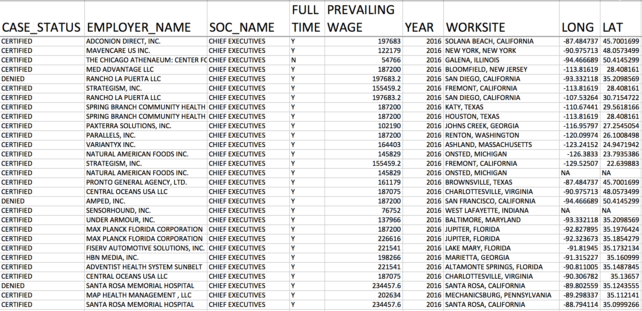
Features
Case Status : Certified, Denied
Employer Name
Certified Rate
Total Petition
Work Site : State
SOC (Standard Occupational Code)
Certified Rate
Total Petition
Full Time: Y or N
Prevailing Wage
Year: 2011 - 2016
LONG

Slide 4
Exploratory Analysis
on Tableau

Slide 5
Modeling

Slide 6
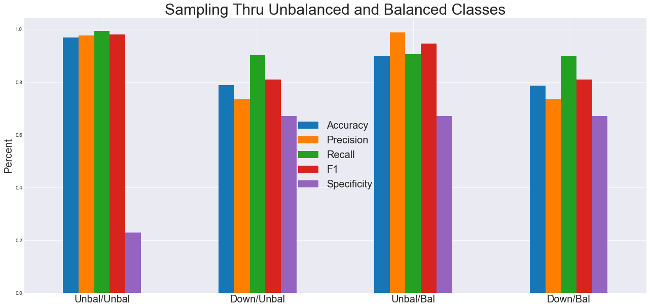
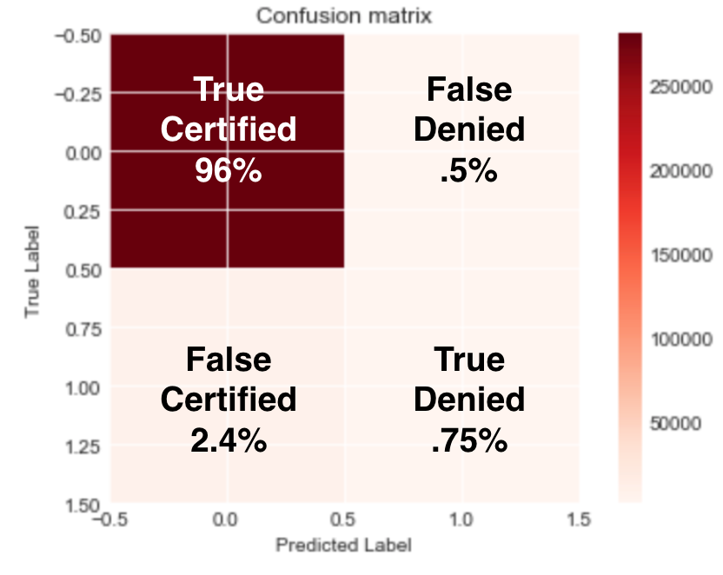
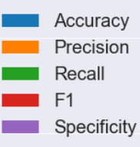

Slide 7
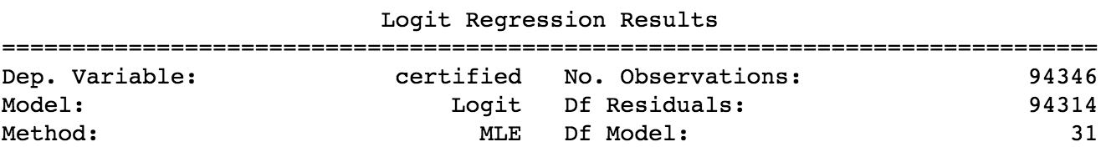
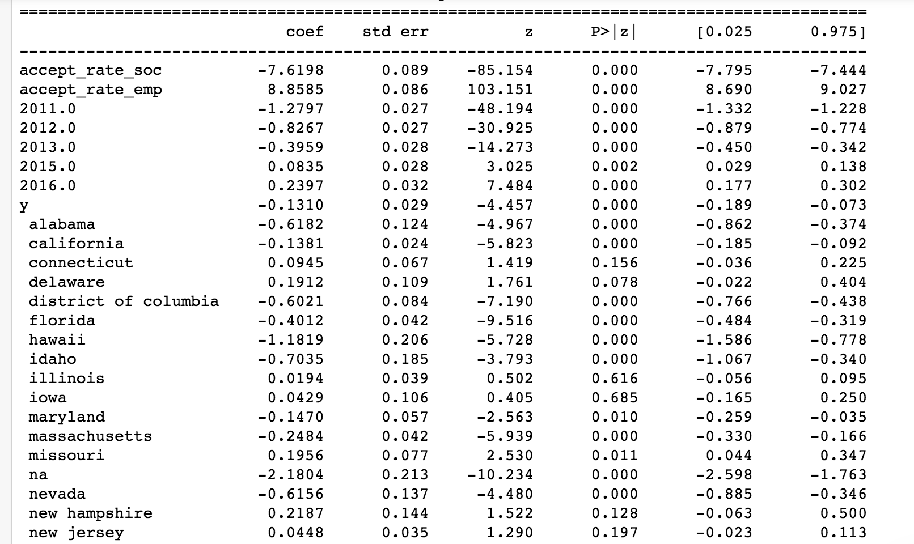
Logistic Regression

Slide 8
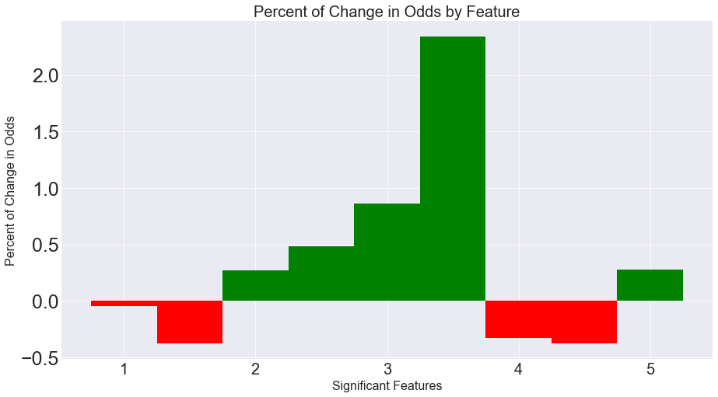
Percent of Change in Odds
234%
27%
5%
38%
33%
38%

Slide 9
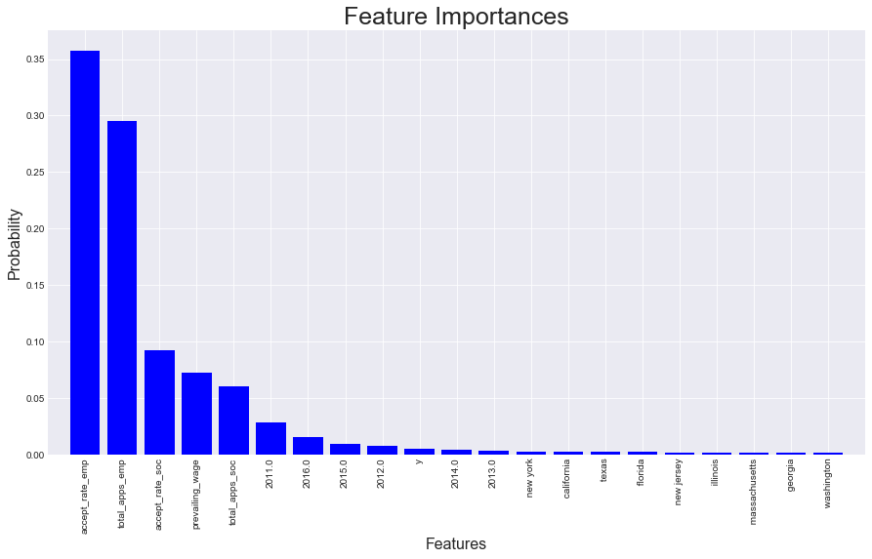
Random Forest

Slide 10
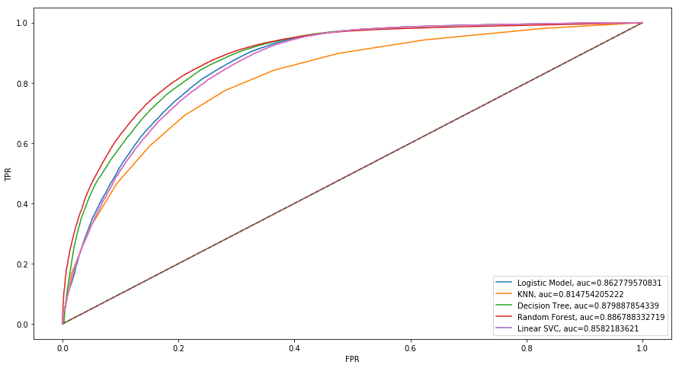
Roc Curve (AUC)

Slide 11
Next Steps
Perform a cost benefit analysis
finding estimate of cost of FN, cost saving TP,
FP (cost of filing) would cost $1,600 USD to $7,400 USD

Slide 12
Thank you!

Slide 13
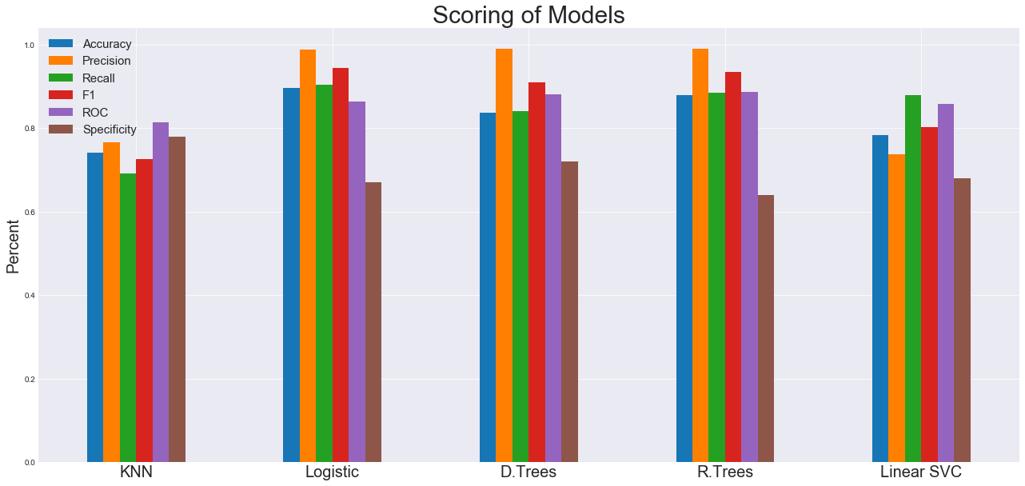

Slide 14
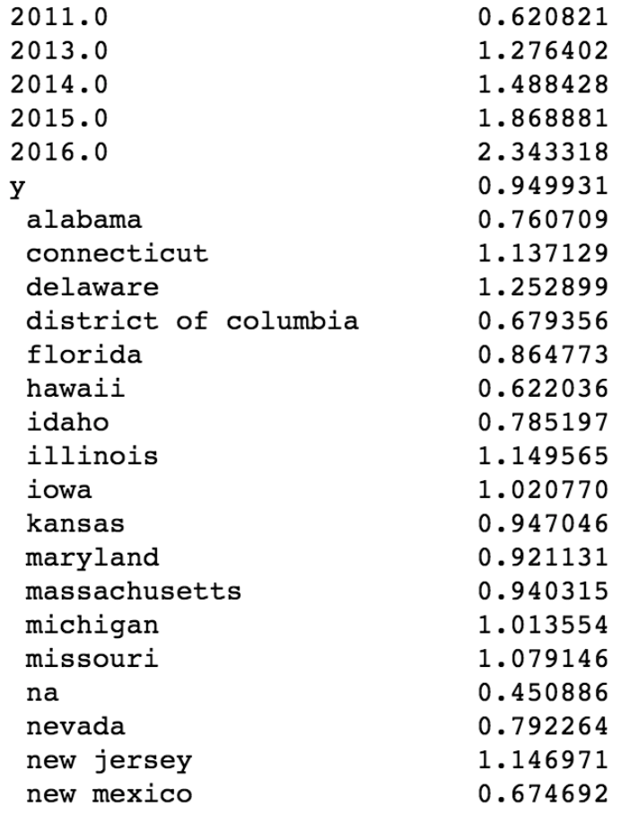
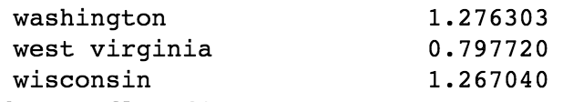
Odd Ratios
38% decrease in odds for petition submitted in 2011
Odds increase by 2.34 times submitted in 2016
Full time position does not have much effect
33% decrease in odds for petition submitted in District of Columbia
27% increase in odds for petition submitted in WA

Slide 15
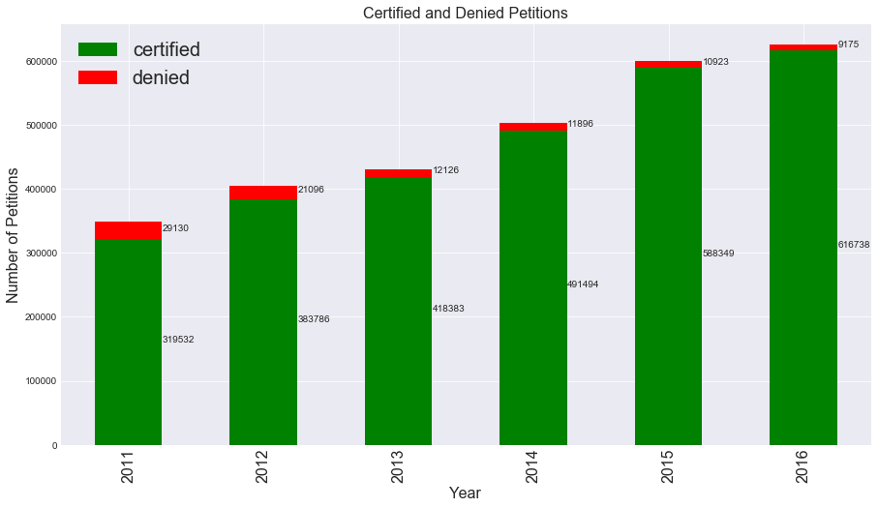

Slide 16
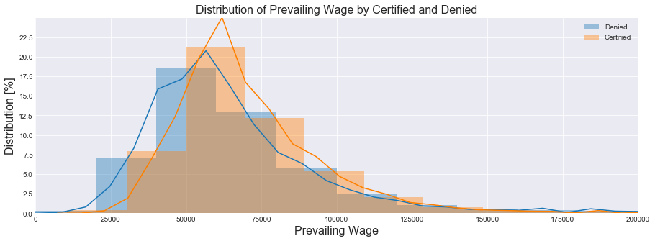
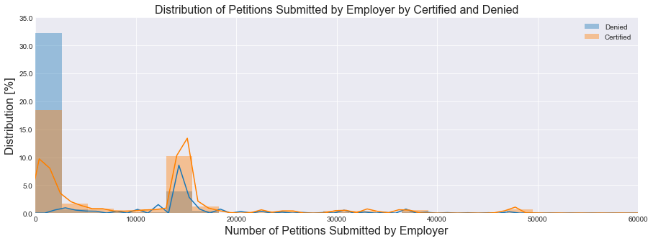

Slide 17
Agenda
Background of H-1B process
Data Features
Exploratory Analysis
Tableau Interactive Dashboard
Classification Models
Conclusions: Flask Demo
Future Steps

Slide 18
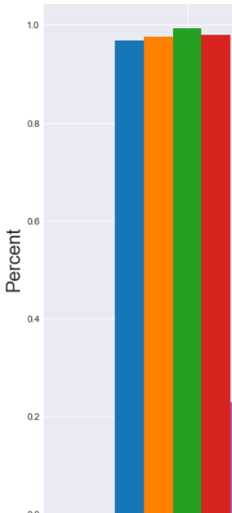

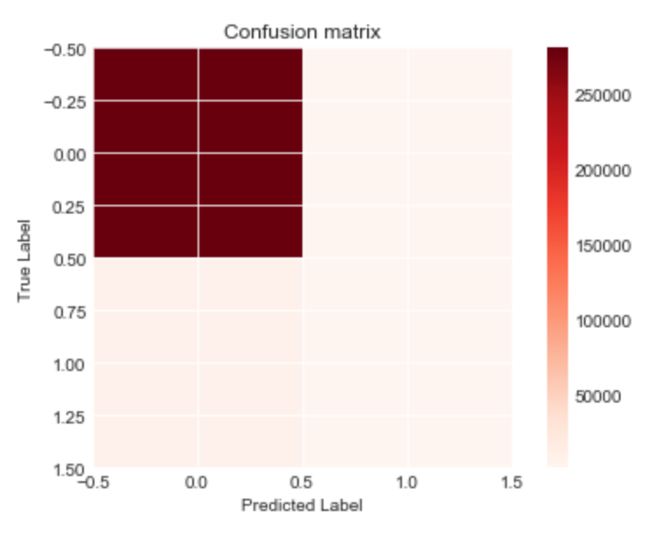
Control Group
True
Certified
96%
False
Denied
.5%
False
Certified
2.4%
True
Denied
.75%

